Slide 1
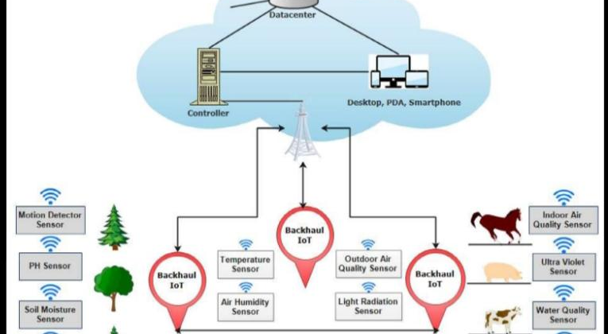
Project Design Phase-I Solution Architecture
Date | 19 September 2022
Team ID | PNT2022TMID50823
Project Name | Smart Crop Protection system for Agriculture
Maximum Marks | 4 Marks
Solution Architecture:
Solution architect ure is a complex process - with many sub-processes - that bridges the gap between business problems and technology solutions. Its goals are to:
• Find the best tech solution to solve existing business problems.
• Describe the structure, characteristics, behavior, and other aspects of the software to project stakeholders.
• Define features, development phases, and solution requirements.
• Provide specifications according to which the solution is defined, managed, and delivered.
Example - Solution Architecture D iagram:
S.N
Figure 1: Architecture and data flow of the voice patient diary sample application
Reference:https://aws.amazon.com/blogs/industries/voice-applications-in-clinical-research- powered-by-ai-on-aws-part-1-architecture-and-design-considerations/

